Slide 1

An introduction to C++ Concepts
Thomas Peters
Dec 13, 2017

Slide 2


Bonjour

Slide 3
Summary
Background, statement of problem.
Overview of Concepts.
How we deal without Concepts today.

Slide 4
Brief summary of templates
Mechanism for generic programming in C++
Instead of:
Can write “a single function”
int add(int x, int y) { return x + y; }
double add(double x, double y) { return x + y; }
template <class T>
T add(T x, T y) { return x + y; }
add(1, 2);
add(3.0, 4.0);
add<float>(1, 2.0);
add(“c++”, “mtl”); // compile error
Notes:
T here is the _template parameter_, a generic type. WHY is this last one a compiler error?

Slide 5
Similar to dynamic languages
Similar to Python:
template <class T>
T add(T x, T y) { return x + y; }
def add(x, y):
return x + y
Notes:
One of the first points students learn about templates is they allow us to write less code. But this is really just the beginning of template power.

Slide 6
Similar to dynamic languages
Actually more similar to:
template <class T>
T add(T x, T y) { return x + y; }
def meta(T):
def add_T(x, y):
return x + y
return add_T

Slide 7
Templates: compile time programming on types
Objects returned by meta functions are (mostly) functions and classes.
Specialization and overloading introduce branching, recursion
Class constants allow computation of (integral) numeric values
Template metaprogramming is Turing complete
Notes:
If you’ve never seen the example of computing factorials or fibonacci numbers with templates, I encourage you to check it out. Turing completeness was an accident. There was a neat talk at the Lambda Montreal (functional programming) meetup which mentioned an implementation of Tetris with templates.

Slide 8
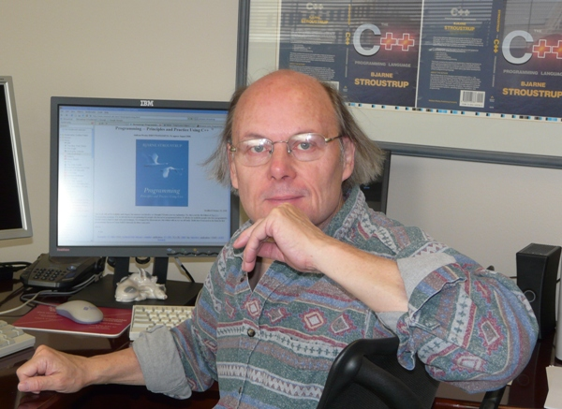
Design goals of templates (1987-8)
Bjarne wanted:
• Full generality/expressiveness • Zero overhead compared to hand coding • Well-specified interfaces
Instead got:
• Turing completeness • better than hand coded performance • Lousy interfaces
Notes:
What do we mean by lousy interfaces? Let’s go back to the add example

Slide 9
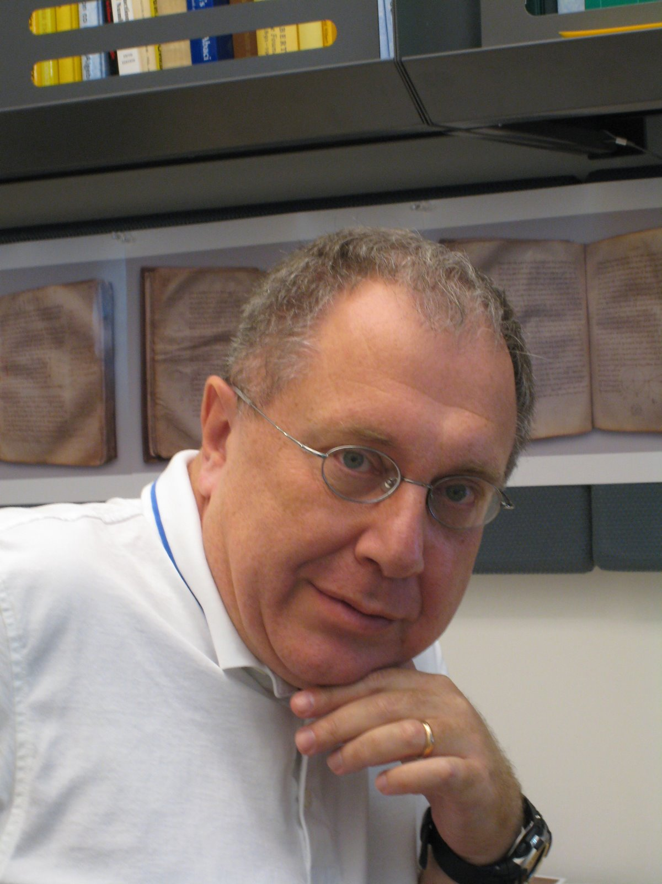
A solution to the interfaces problem is called Concepts.
Originally proposed by Alexander Stepanov
(father of the STL)
Notes:
I’d also mention to any Python programmers that Python has a similar problem and recognizes it: there’s a typing module, optional function annotations, and the mypy project for static type checking

Slide 10
Lousy interfaces.
std::vector<int> vec { 1, 2, 3, 4 };
std::sort(vec.begin(), vec.end()); // OK
std::list<int> a_list { 1, 2, 3, 4 };
std::sort(a_list.begin(), a_list.end());
What could go wrong? (hop over to godbolt.org)

Slide 11
Compiler barfs
std::sort is an unconstrained template
Templates use compile time duck typing
Errors are very much in the weeds, and don’t offer helpful clues
Notes:
Types are deduced (a quite complicated process), and if anything doesn’t make sense on the deduced types the compiler pukes. Errors are in the details. As a python programmer, when I break an interface, I often feel like the kinds of (runtime) errors i get by breaking an interface are much like template errors. But let’s face it, template errors are the worst of all errors.

Slide 12
Implicit interfaces
template<class T>
void sort(T& c) { // code for sorting (depending on various properties of T, // such as having [ ] and a value type with < }
Notes:
The requirements of sort here are implicit: they’re in the implementation

Slide 13
Concepts provide explicit requirements:
template<class T>
requires Sortable<T>
void sort(T& c) { // ... }
// or:
void sort(Sortable& c) { // ... }
//or
template <Sortable T>
void sort(T t) { … }
Notes:
They make code more readable. Why would the second form be frowned upon? What happens if you try to instantiate on something not Sortable? That _in itself_ is not an error: it just means that that particular overload does not exist. Another one may match. If not, you’ll get a compile error

Slide 14
Concepts make code more readable

Slide 15
Better error messages
sort(lst);
error: cannot call function 'void sort(T&) [with T = std::list<int>]' note: concept 'Sortable()' was not satisfied

Slide 16
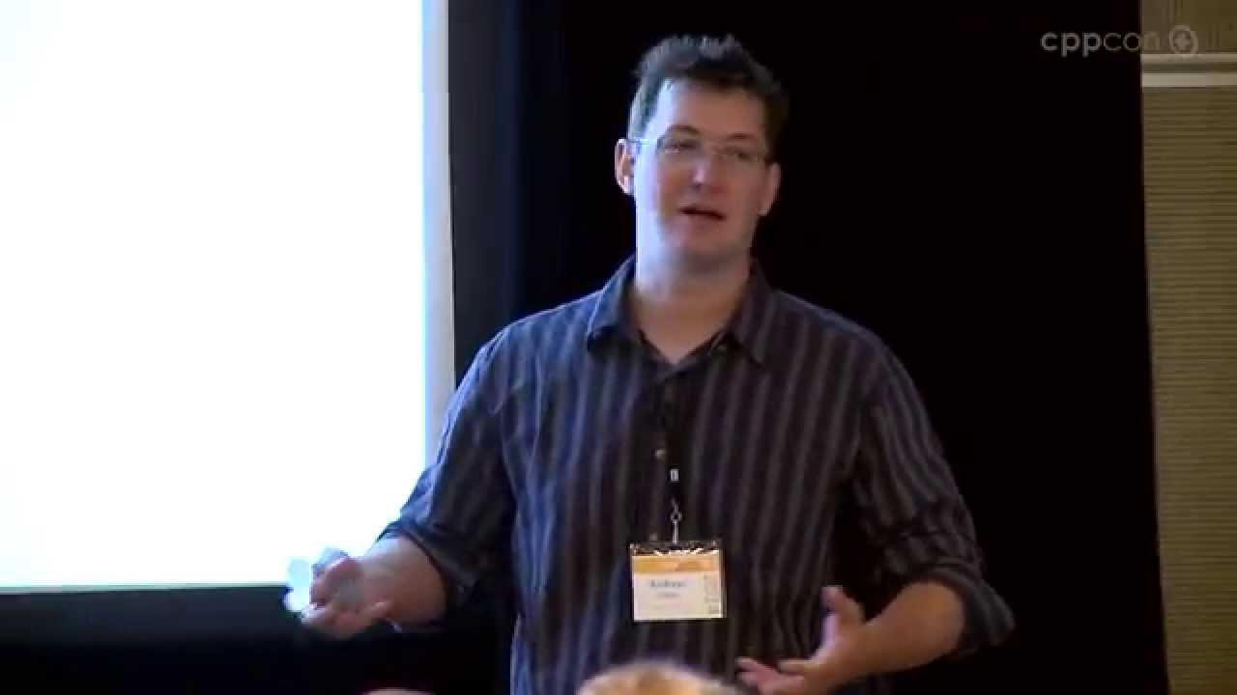
Status of Concepts
Voted down for C++11 (different version)
Voted down for C++17 (“concepts-lite”)
Candidate for C++20 (merged into working draft)
GCC 6 already ships with concepts (Andrew Sutton)
Only the language features
No standard library
Need -fconcepts flag
Try on godbolt.org!
Andrew Sutton, architect of concepts ->
Notes:
Evolution working group moved to merge concepts into C++17 but it was turned down. We’ll talk about why later. Can play with concepts in godbolt’s compiler explorer! In fact that’s a great place to explore templates because much of the battle is just getting compilation

Slide 17
Concepts today
Consider std::find (http://en.cppreference.com/w/cpp/algorithm/find)
template <class InputIt, class T>
InputIt find(InputIt first, InputIt last, const T& value);
Type requirements
InputIt must meet the requirements of InputIterator.
Notes:
Concepts sort of exist in C++, particulary the STL, at least as a form of documentation. Many of us have heard of things like “random access iterator” or “bidirectional iterator”. These are all concepts. (By the way, the Ranges TS will hopefully change the way we work with such algorithms)

Slide 18
Example Concept: InputIterator
http://en.cppreference.com/w/cpp/concept/InputIterator
Gives a list of requirements that must be satisfied by an InputIterator.
Not enforced by the compiler
Similar definitions exist in Boost too.

Slide 19
Eventually may see:
template <class R, class T>
requires Range<R> && EqualityComparableWith<Value_type<R>, T>
Iterator_of<R> find(R& range, const T& value);
// Using template aliases
template <class X> using Value_type = X::value_type;
template <class X> using Iterator_of = X::iterator;
Notes:
(don’t take this for gospel, it’s inspired by the Ranges TS).

Slide 20
Concepts not only introduce requirements on single types, but on relationships between types
Eg, EqualityComparableWith<Value_type<R>, T>
See the Ranges TS for a language feature built with Concepts (http://en.cppreference.com/w/cpp/experimental/ranges)

Slide 21
Defining concepts
template < template-parameter-list >
concept [bool] concept-name = constraint-expression;
Examples:
// variable concept template <class T, class U> concept bool Derived = std::is_base_of<U, T>::value; // function concept (must be invoked) template <class T> concept bool EqualityComparable() { return requires(T a, T b) { {a == b} -> Boolean;
{a != b} -> Boolean; };
}
Constraint expression
Notes:
Here our first concept is defined in terms of an existing language feature from type_traits

Slide 22
Constraints
1) conjunctions 2) disjunctions 3) predicate constraints 4) expression constraints (only in a requires-expression) 5) type constraints (only in a requires-expression) 6) implicit conversion constraints (only in a requires-expression) 7) argument deduction constraints (only in a requires-expression) 8) exception constraints (only in a requires-expression) 9) parametrized constraints (only in a requires-expression)
Notes:
Constraints can model some, but not all, of the C++ language features.
IDEA: explain a few of these in more detail

Slide 23
More examples: Range
template <class T>
concept bool Range = requires(T t) {
typename Value_type<T>; // must have a value type typename Iterator_of;
typename Iterator_type<T>; // must have an iterator type
{ begin(t) } -> Iterator_of<T>; // must have begin() and end() which return iterators
{ end(t) } -> Iterator_of<T>;
requires Input_iterator<Iterator_of<T>>;
requires Same_type<Value_type<T>, Value_type<Iterator_of<T>>>;
};

Slide 24
More examples: Sortable
template <class T>
concept bool Sortable =
Sequence<T>
&& Random_access_iterator<Iterator_of<T>>
&& Less_than_comparable<Value_type<T>>
;

Slide 25
Template overloading
template<class T1, class T2> void f(T1, T2); template<class T> void f(T);
void f(int, int); // takes precedence over template functions
void f(int, int, int);
It’s hard to provide overloads based on particular properties of T.
Notes:
Some template overloading is easy. Other types are hard. With vanilla unconstrained templates, and without special techniques (which we’ll touch on) you can’t really do it, unless you change your function signature. Python too doesn’t allow overloading either, though there are libraries, based on metaprgramming, which support it.

Slide 26
Concepts: overloading
void advance(Forward_iterator p, int n) { while(n--) ++p; }
void advance(Random_access_iterator p, int n) { p+=n; }
void use(vector& vs, list& ls) {
auto pvs = find(vs, "foo");
advance(pvs, 2); // use fast advance
auto pls = find(ls, "foo");
advance(pls, 2); // use slow advance
}
Notes:
Common sense rules apply: if concepts are disjoint, pick which (if any) applies. If both apply and one is more specialized than another, pick more specialized. Otherwise fail with ambiguous call

Slide 27
Concepts: constrained type deduction
// the type of x1 is deduced to whatever f returns
auto x1 = f(y);
// Return type of f must satisfy Sortable concept to compile Sortable x2 = f(y);

Slide 28
Dealing without concepts 1
Do nothing. Cry.
Use documentation (like the STL)
Use gcc 6 with -fconcepts

Slide 29
Dealing without concepts 2: plain ol’ templates
template<class T1, class T2> struct Can_copy { static void constraints(T1 a, T2 b) { T2 c = a; b = a; } Can_copy() { constraints; } };
struct X {}; struct Y {};
Can_copy<X, Y>();
// Gcc 6.1 output
<source>: In instantiation of 'static void Can_copy<T1, T2>::constraints(T1, T2) [with T1 = X; T2 = Y]': 7 : <source>:7:22: required from 'Can_copy<T1, T2>::Can_copy() [with T1 = X; T2 = Y]' 22 : <source>:22:23: required from here 6 : <source>:6:54: error: conversion from 'X' to non-scalar type 'Y' requested static void constraints(T1 a, T2 b) { T2 c = a; b = a; } ^ 6 : <source>:6:59: error: no match for 'operator=' (operand types are 'Y' and 'X') static void constraints(T1 a, T2 b) { T2 c = a; b = a; } ~~^~~
Notes:
You can express constraints without declaring or copying variables, thus the writer of a constraint doesn’t have to make assumptions about how a type is initialized, whether objects can be copied, destroyed, etc. (unless, of course, those are the properties being tested by the constraint)
No code is generated for a constraint using current compilers
No macros are needed to define or use constraints

Slide 30
Dealing without concepts 3: static_assert
template <class T>
void foo(T&t) {
static_assert(std::is_integral<T>::value);
// ....
}
Errors still come out of body, just as without.
Again, interface is specified in implementation (function body)
Doesn’t allow overloading
Notes:
(you can remove the errors from inside the body with some trickery thgouh)

Slide 31
Dealing without concepts 4: tagged-dispatch
namespace std { struct input_iterator_tag { }; struct bidirectional_iterator_tag { }; struct random_access_iterator_tag { }; namespace detail { template <class InputIterator, class Distance> void advance_dispatch(InputIterator& i, Distance n, input_iterator_tag) { while (n--) ++i; } template <class BidirectionalIterator, class Distance> void advance_dispatch(BidirectionalIterator& i, Distance n, bidirectional_iterator_tag) { if (n >= 0) while (n--) ++i; else while (n++) --i; }
template <class RandomAccessIterator, class Distance> void advance_dispatch(RandomAccessIterator& i, Distance n, random_access_iterator_tag) { i += n; } } template <class InputIterator, class Distance> void advance(InputIterator& i, Distance n) { typename iterator_traits<InputIterator>::iterator_category category; detail::advance_dispatch(i, n, category); } }
// A technique for selecting implementations based on compile time properties.
Notes:
The iterator_traits thing there is a sort of metafunction: it computes (at compile time) a certain associated type to the template argument InputIterator

Slide 32
Dealing without concepts 5: constexpr if
template <class T>
void foo(T t) { // C++17 feature
if constexpr (std::is_integral<T>::value) {
// provide int implementation
} else {
// provide non-int implementation
}
}

Slide 33
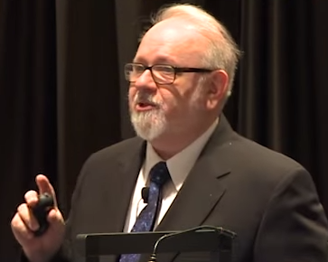
Dealing without concepts 6: SFINAE
template <class T, typename = std::enable_if_t<std::is_integral<T>::value>> // C++14, almost C++11
void foo(T t) { } // basically equivalent to requires Integral<T>
template <class T>
auto bar(T t) -> decltype(t.member_func(), void())
{} // disabled unless has a member function named
// `member_func` which accepts no arguments
Also see void_t, or any talk by Walter Brown. (C++17, yet trivial to implement)
Notes:
“this template is invisible when the corresponding condition is not satisfied”. SFINAE is an extremely powerful metaprogramming technique which can do things like add member function templates if a condition is satisified, overload templates, or even add member (an alternative to ifdefs). You can create custom classes at compile time based on type reflection

Slide 34
Dealing without concepts 6: SFINAE
SFINAE is almost as powerful as concepts. Can almost implement concepts!
https://stackoverflow.com/questions/26513095/void-t-can-implement-concepts
https://akrzemi1.wordpress.com/2016/03/21/concepts-without-concepts/
http://www.boost.org/doc/libs/1_60_0/libs/concept_check/concept_check.htm
SFINAE can’t apply to things like constructors in a template class
SFINAE can’t do partial ordering of overloads
SFINAE is ugly, and hard to get right.

Slide 35
Why concepts didn’t make C++17?
Only one implementation (gcc)
Not enough use cases seen (Ranges TS biggest example)
No library of concepts
No checking of template definitions
Sometimes, error messages are worse
You can end up with a large set of discarded overloads, each with its own reason for rejection.
See http://honermann.net/blog/ for examples

Slide 36
Conclusion: Concepts simplify generic programming
Improve readability
Improve error messages (hopefully)
Provide explicit interfaces for templates
Easier overloading, specialization of templates
Restricted type deduction (auto replacement)
Unclear if will make it as a real language feature.
Summary:
A C++ concept is a compile-time predicate on zero or more template argument type argument or value arguments.

Slide 37
References
http://en.cppreference.com/w/cpp/language/constraints
http://www.open-std.org/jtc1/sc22/wg21/docs/papers/2017/p0557r0.pdf
Contact: thomas.d.peters@gmail.com

